Slide 1
Nrf1 proteomics
Brendon Smith
2016-2017

Slide 2
Hypothesis
Nrf1 forms an ER sterol responsive complex to maintain cellular cholesterol homeostasis

Slide 3

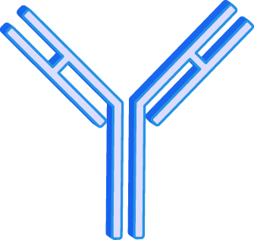
Nrf1 proteomics experimental design
n time
Adenovirus
lacZ
Nrf1-HA
Chow
Chow
Cholesterol
Bortezomib
Adenovirus
Liver ER fraction
HA IP
Mass spectrometry
6
Bl/6WT
Male
4
4 1 week
(Paigen diet)
4 6 hours
Anti-HA tag agarose resin
(ThermoFisher 26182)
No pre-clearing
ThermoFisher Center for Multiplexed Proteomics

Slide 4
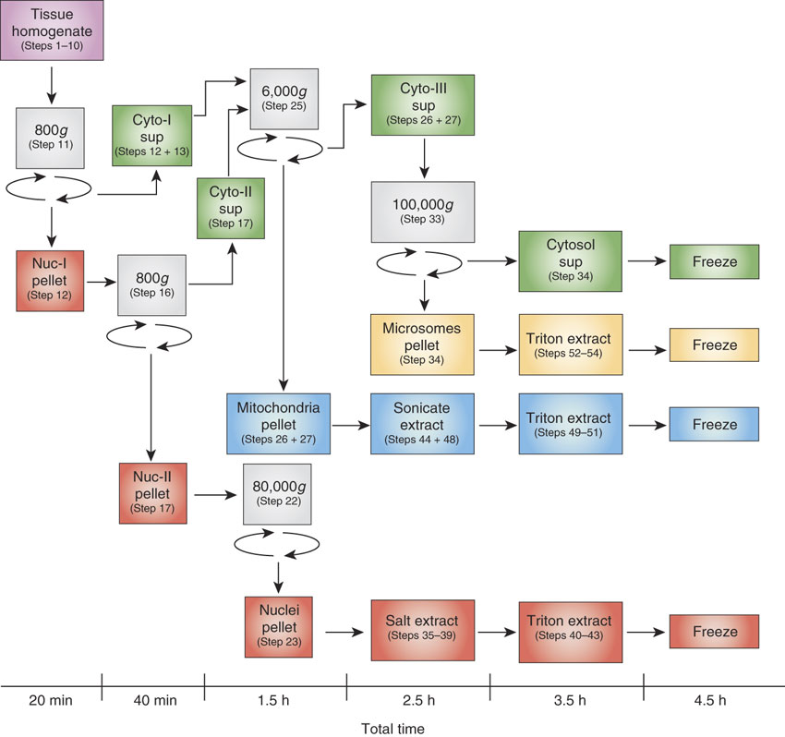
Subcellular fractionation
Cox B, Emili A. Tissue subcellular fractionation and protein extraction for use in mass-spectrometry-based proteomics. Nature Protocols 1:1872–1878 (2006).
RIPA buffer extract
BCA
IP
Elute
Freeze
Microsome extraction buffer:
RIPA with protease/phosphatase inhibitors

Slide 5
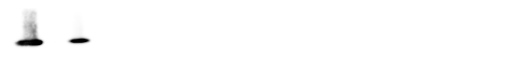
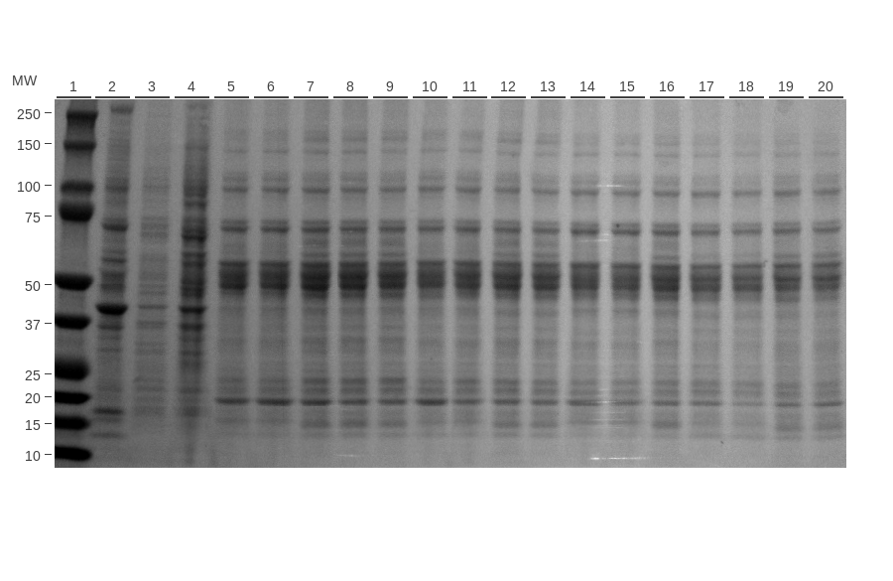
Fractionation results
Nrf1
Na K ATPase
Histone H3
Lamin A/C
COX IV
Calreticulin
Ponceau S
KO
293 Epoxo
M | N
lacZ
Nrf1-HA
Chow
Nrf1-HA
Cholesterol
Nrf1-HA
Bortezomib
Controls
Microsomal input
Notes:
UPDATED WITH CROSS-REACTIVE ANTIBODIES FOR COX IV AND NA,K-ATPASE

Slide 6
Complement C1q A, B, and C were increased in abundance in cholesterol-fed mice
Colored points:
Each point is a protein
red if p<0.05
orange if [log2FC]>1
green if both
Plot generated in R

Slide 7
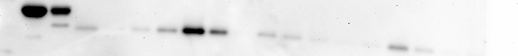
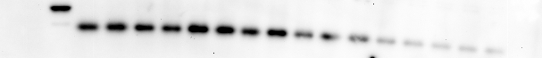
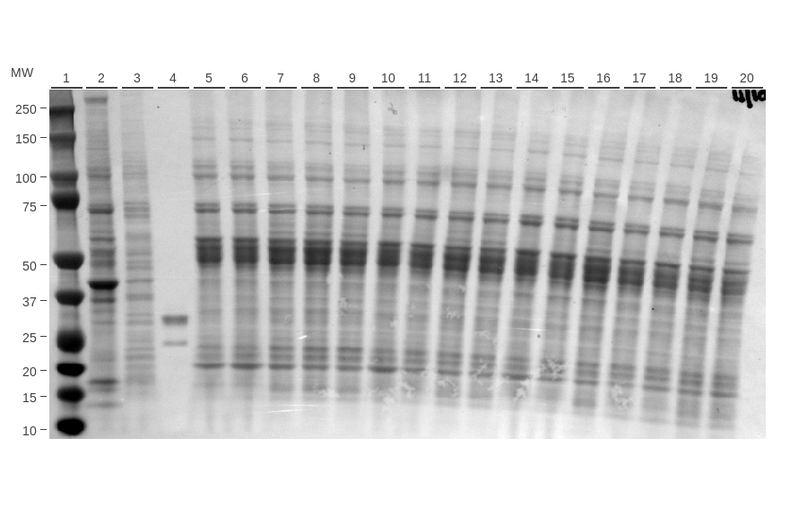
Complement C1q A Western blots do not match mass spec results
IP: HA
IB: C1q
Input
IB: C1q
Input
Ponceau S
Purified C1q A
lacZ
Nrf1-HA
Chow
Nrf1-HA
Cholesterol
Nrf1-HA
Bortezomib
Notes:
Lane 1: Nrf1 KO MEF
Lane 2: 293 microsomal

Slide 8
Bortezomib altered the proteome
Colored points:
Each point is a protein
red if p<0.05
orange if [log2FC]>1
green if both
Plot generated in R

Slide 9
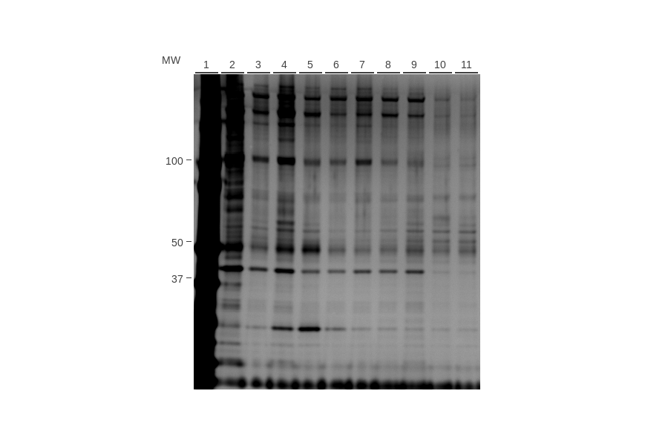
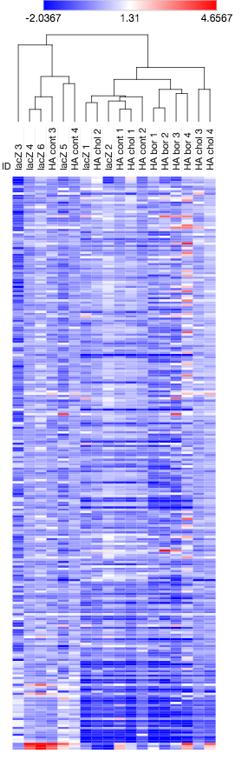
Limitations of experiment
Low and inconsistent protein pulldown
Reliance on gels requires elution from beads and high [protein]
Silver stained gel shown at left. For mass spec, separate gels were run and stained with Coomassie blue.
Nrf1: ~100-120 kDa
Proteome not different with or without HA tag
lacZ
Nrf1-HA
Chow
Chol
Bort
Samples did not cluster by treatment group
Values: log2(FC/mix). Proteins sorted by log2(FC HA chol/HA chow), low to high left to right. Clustered by one minus Pearson correlation. Plotted in Morpheus.
Nrf1 was not detected by mass spec.
Trypsin may not effectively digest Nrf1. I have used chymotrypsin previously with better results.
Turnaround time: >2 months
Cost: $2800 (two 9-plexes)

Slide 10
Subcellular fractionation
Adjustments to procedure for future experiments
Cox B, Emili A. Tissue subcellular fractionation and protein extraction for use in mass-spectrometry-based proteomics. Nature Protocols 1:1872–1878 (2006).
BCA
IP
Digest
MS/MS
Microsome extraction buffer:
20 mM Tris-HCl (pH 7.8), 0.4 M NaCl, 15% glycerol, 1.5% Triton X-100, protease/phosphatase inhibitors

Slide 11
Nrf1 proteomics future experiment
Male | Female | Time
3-5 | 3-5
3-5 | 3-5 | 1 wk
3-5 | 3-5
3-5 | 3-5 | 1 wk
Nrf1 fl AlbCre
Cre+
Cre-
Chow
Chow
Cholesterol
Cholesterol
Nrf1 flox/flox
Albumin Cre
Liver ER fraction
Nrf1 IP
Mass spectrometry
(Paigen diet)
Pre-clear with Protein A/G magnetic beads
IP with Nrf1 antibody (CST 8052) crosslinked to Protein A/G magnetic beads (ThermoFisher 88803)
On-bead digestion

Slide 12
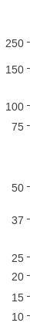
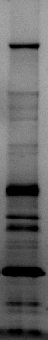
Nrf1 interacting proteins were identified by mass spec
HEK-293 A cells Nrf1-HA 1-741
Nuclear fraction
HA IP
Identify Nrf1 and interacting proteins by mass spectrometry
Separate proteins on gel, stain, excise bands
Cholesterol (6 hours) Epoxomicin (6 hours)
Nrf1
OGT
HCFC1
Blue-stained gel
Cells: HEK-293 A Nrf1-HA 1-741
Fraction: nuclear
Treatment: epoxomicin
Notes:
Left: study design
Right: Example gel. I cut bands out of the gel and they were analyzed by mass spec
Chart: # peptides identified with mass spec corresponding to each protein. Band 1 is the top Nrf1 band, band 2 middle, band 3 lower.
Full results can be found in the “Mass spectrometry” section of 20160316 HEK-293 A Nrf1-HA 1-741 mass spectrometry OGT HCFC1.

Slide 13
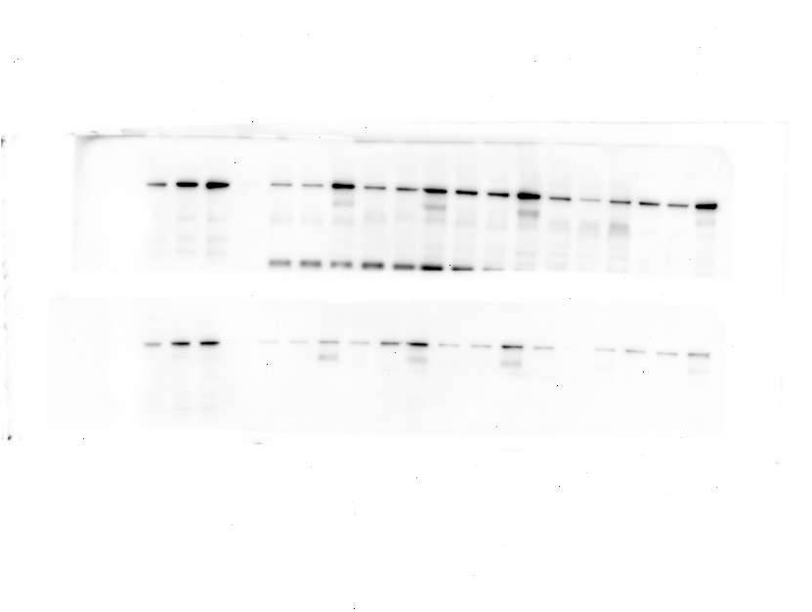
OGT and HCFC1 interact with Nrf1 in the nucleus
IP: Nrf1
IB: OGT
IB: HCFC1
Epoxomicin
Cholesterol
Control
Cells: HEK-293 A Nrf1-HA 1-741
Fraction: nuclear
Treatment: control, cholesterol, epoxomicin
Notes:
This slide shows follow up blots to demonstrate the OGT and HCFC1 interactions identified previously by mass spectrometry. The samples shown on this slide were not analyzed by mass spectrometry.
Left: Western blots of IP eluates from HEK-293 A Nrf1-HA 1-741 cells (blots done on 10/6/16). For each cell fraction, the left lane is control, center is cholesterol, right is epoxomicin. IP=immunoprecipitation, IB=immunoblot
Right: quantification of Western blot signal after Nrf1 IP, normalized to input (signal from protein lysate before IP). This quantification is from blots done on 11/18/16 (different blots than the image at left).

Slide 14
TCMP Experimental workflow
Sample prep
Samples were submitted in gel loading buffer. 5µl of each sample was combined for the “mix” sample to be included in both experiments. 30µl of each sample was loaded into 10% Bis/Tris gels and run at 120V for 12 minutes. Gels were stained for 2 hour with Coomassie and destained overnight in water. No bands were visible in tc-d279g gels. Remaining sample was loaded into new gels, stained, and destained overnight.
Gel bands or approximate areas were cut out, destained, reduced, and alkylated. In-gel Trypsin digests were performed and peptides were extracted and labeled with TMT10 reagents. Labeling reactions were combined, cleaned, and dried down. Peptides were resuspended in 5% Acetonitrile, 5% formic acid and ½ of the sample was shot on an Orbitrap Fusion Mass spectrometer.
Data analysis
MS2 spectra were searched using the SEQUEST algorithm against a Uniprot composite database derived from the mouse proteome containing its reversed complement and known contaminants. Peptide spectral matches were filtered to a 1% false discovery rate (FDR) using the target-decoy strategy combined with linear discriminant analysis.
The proteins were filtered to a <1% FDR.
Proteins were quantified only from peptides with a summed SN threshold of >=200 and MS2 isolation specificity of 0.5.
Turnaround time: >2 months
Cost: $2800 (two 9-plexes)
Gel
Search, filter
&
compile data
Digest
Label Peptides
LC-MS3
Combine Samples

Slide 15

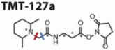
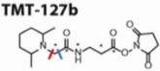
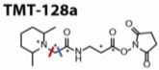
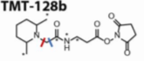
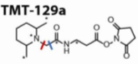
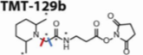
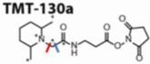
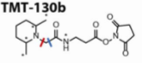
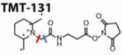
Tandem Mass Tags for Multiplexed Proteomics
2 3 4 5 6 7 8 9 10
Precursor ion (MS1 scan)
Reporter ion quantification
(MS3 scan)
Peptide Sequencing
(MS2 scan)
m/z
m/z

Slide 16
Mouse liver proteomics pilot experiment 1
Nrf1 fl AlbCre
Cre+
Cre-
Chow
Chow
Nrf1 flox/flox
Albumin Cre
Liver ER fraction
Nrf1 IP
Mass spectrometry
n=2
n=2
Beads
Beads+Nrf1 IP +X-link
Beads+Nrf1 IP
Beads
IP
Pre-clear with Protein A/G magnetic beads
IP with Nrf1 antibody (CST 8052) on Protein A/G magnetic beads (ThermoFisher 88803)
Farese/Walther lab
On-bead digestion

Slide 17
Mouse liver proteomics pilot experiment 2
Bl/6
Chow
Liver ER fraction
Nrf1 IP
Mass spectrometry
Dounce
Detergents
Motorized P-E
Fractionation
Beads
Beads+Nrf1 IP +X-link
Beads+IgG+ X-link
IP
Pre-clear with Protein A/G magnetic beads
IP with Nrf1 antibody (CST 8052) on Protein A/G magnetic beads (ThermoFisher 88803)
Farese/Walther lab
On-bead digestion

Slide 18
Pilot+full experiment on same slide
Nrf1 fl AlbCre
Cre+
Cre-
Chow
Chow
Cholesterol
Cholesterol
Male | Female | Time
3-5 | 3-5
3-5 | 3-5 | 1 wk
3-5 | 3-5
3-5 | 3-5 | 1 wk
Nrf1 flox/flox
Albumin Cre
Liver ER fraction
Nrf1 IP
Mass spectrometry
(Paigen diet)
Pilot experiment:
2-3 male Cre+
2-3 Cre-
Chow diet
Protein A/G magnetic beads (ThermoFisher 88803)
Crosslinked Nrf1 antibody (CST 8052)
Pre-clear with Protein A/G beads

